Slide 1

Compulse
Control
An answer for impulsive purchasing

Slide 2
TABLE OF CONTENTS
01
04
Project Objectives
Use of OnDemand API's
02
05
Features & Functionality
Team Contribution
03
06
Technical Challenges & Solutions
Future Scope
The Problem and how Behavioural Insights can help
Knowledge Agents
Implementing the solution in Chrome
Role division to create the project
Interaction, code integration, combination of functions
Future directions to improve user experience

Slide 3
Project Objectives
Behavioural Insights Backed Objectives:
Chrome extension for real-time spending support
AI-driven insights and prompts at checkout
Personalized based on user’s spending data
The Problem:
Compulsive spending affects 5-8% of the general population, leading to financial and social issues.
Notes:
Compulsive spending has become a widespread issue, with studies estimating that between 5-8% of the general population engage in problematic, impulsive spending. This behavior often contributes to financial stress, debt, and strained relationships, affecting individuals across demographics and regions. Today’s highly digital consumer environment, with endless online shopping options and targeted marketing, makes it harder for many to manage spending impulses.
While compulsive spending affects a broad range of individuals, it is also prevalent among those with certain mental health conditions. People experiencing anxiety disorders, obsessive-compulsive disorder (OCD), and attention-deficit/hyperactivity disorder (ADHD) may be particularly vulnerable to compulsive shopping as a means of emotional regulation. In these cases, spending can become a way to cope with stress or negative emotions, providing a temporary “high” that soon dissipates, leading to a harmful cycle of buying and regret.
Behavioral insights provide practical, scientifically-backed strategies that can improve financial decision-making at crucial moments. In our project, we’re incorporating several such insights:
1. Self-reflection prompts: Encouraging self-reflection helps users examine the motivations and potential consequences of their spending decisions. Studies show that prompting users to think about their values or goals before a purchase can increase awareness and help them make more intentional choices.
2. Nudges for delayed gratification: Compulsive spending often arises from the desire for immediate rewards. Research on consumer behavior highlights that nudges promoting a delay—such as suggesting users "sleep on it" or return to the item later—effectively reduce impulsive purchases. Strategies like these draw on Thaler and Sunstein’s concept of “nudging” and have been shown to support better spending choices by counteracting impulsive behaviors and increasing control over spending.
3. Personalized budget reminders: Reminding users of their monthly budget or the opportunity cost of a purchase can help them make financially healthier decisions. Budget-based prompts that encourage users to think about trade-offs (e.g., considering whether a purchase aligns with saving for larger goals) leverage behavioral insights to help maintain focus on long-term financial health.a|
These methods provide a mix of cognitive strategies and prompts to make responsible spending easier and more intuitive for users. Our extension aims to integrate these insights at key moments, promoting mindfulness and reducing impulsive spending at online checkouts.
Overall objectives:
Chrome extension for real-time spending support
AI-driven insights and prompts at checkout
Personalized based on user’s spending data

Slide 4
Features & Functionality
We designed a chatbot that serves as an intelligent financial assistant, using behavioral insights to help users reflect on spending patterns based on their transaction history.

Slide 5
Basic Framework
On-Demand Agent Deployment
Chatbot REST API
WebSocket for Real-Time Communication
Agents are available on-demand, powered by the GPT-4.0 model to provide intelligent, context-aware responses.
We employ a REST API to connect to the on-demand server, facilitating bidirectional interactions between the chatbot and backend, allowing it to retrieve and process user-specific data dynamically.
WebSocket connection enables continuous, bidirectional communication

Slide 6
Basic Framework
Chrome Extension
Testing with Mock Data
The chatbot is delivered through a Chrome extension, which will enable us to later integrates seamlessly into the user’s browsing experience, particularly on e-commerce sites.
We simulate user transaction history through mock data to rigorously test the chatbot’s response patterns, ensuring accurate and relevant advice based on spending history.

Slide 7
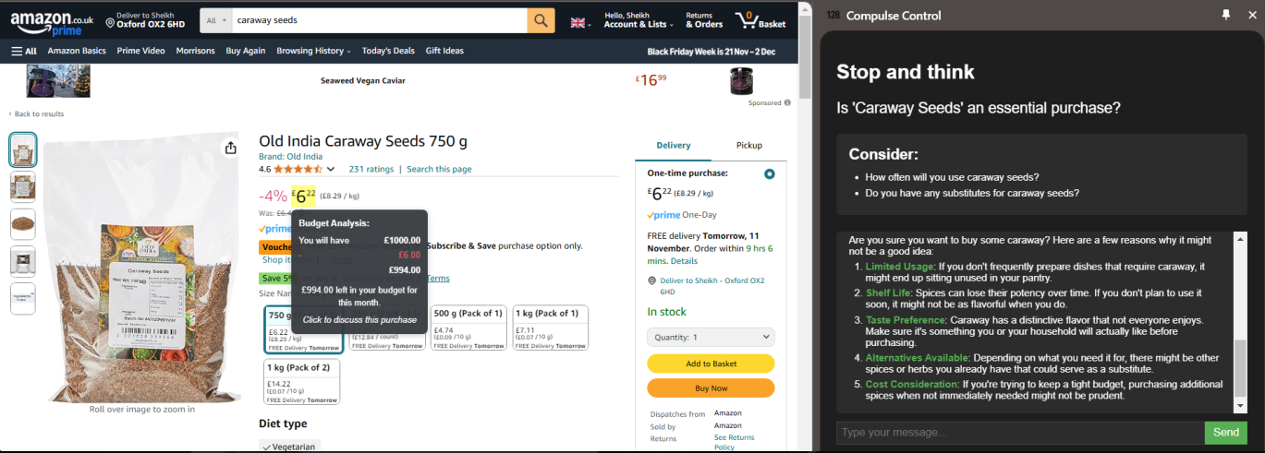
DEMO

Slide 8
Technical Challenges & Solutions
Interaction
Code Integration
Combination of Functions
Initially, we explored multiple methods to integrate the on-demand functionality into the main design and thoroughly tested the platform’s capabilities. Through this iterative process, we achieved a bidirectional interaction between users and the on-demand agent, accessible via a pop-up interface.
The second issue was code integration. We resolved this by isolating issues, conducting targeted testing, and streamlining data handling, ultimately achieving smooth integration.
The final issue is combining different functions, our current main focus. We plan to enhance this further by integrating the pop-up with real-time interactive notifications on the webpage.

Slide 9
Use of OnDemand API's
API Key
Knowledge Agent
Playground Preset
Using OnDemand’s public API key based authentication. Allowing for our application to access OnDemand models without having them downloaded.
We created a knowledge agent equipped with our transaction dataset. API requests could include it simply by referring its plugin ID
OnDemand documentation taught us how to include presets in our requests, quickly retrieving our custom configurations.

Slide 10
Team Contributions
Stage 2: Project Implementation
Mingda Santos: Project Engineering, Project Lead
Ying Ying Lim: Software + Data Engineering
Sheikh Mohiddin: UI/UX Design and Implementation
Francis Madden: Behavioural science lead, asset creation, icon design, and QA testing
Connie Li: Input-output testing, slide presentation
Stage 1: brainstorming about the idea and voting on potential projects- everyone is involved
Stage 3: Wrap-up and Final Preparation - Front end (Sheikh and Mingda) and backend (YIng); prompt and slides (Francis and Connie)

Slide 11
Future Scope
Integration
Data Tracking
Information
The final issue is combining interactive notifications triggered by mouse hover on the webpage with the pop-up. This integration will enable a seamless user experience, providing real-time alerts and advice without interrupting the browsing flow.
To address privacy concerns, we track data without storing identifiable information, ensuring user anonymity. This will also enables researchers to access aggregated, anonymized data for behavioral studies.
By specifying the time length beforehand, the system can provide more accurate budget analysis, offering tailored insights based on the user’s spending patterns over a defined period.
Notes:
To address privacy concerns, we track data without storing identifiable information, ensuring user anonymity. This allows users to benefit from personalized insights based on their transaction history, while also enabling researchers to access aggregated, anonymized data for behavioral studies. This approach maintains privacy while supporting valuable research on individual spending behaviors.

Slide 12
THANKS!
Does anyone have any question?

